Slide 1
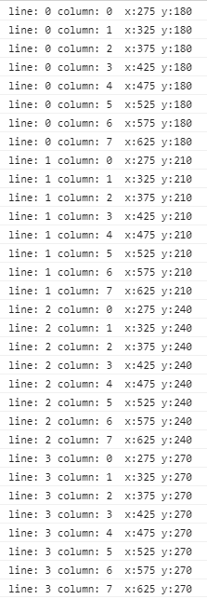

Create enemies - Starting positions
0
900 px
center: 450
top: 150
active playing field
750 px

